Slide 1
Cues in hiring processes: What are you signaling to underrepresented groups?
Ann Marie Ryan
Michigan State University

Slide 2
Outline
Terms and definitions
Identity contingency cues in recruitment and selection
  Probable and possible
  State of stereotype threat research in selection contexts
Addressing threat and promoting safety

Slide 3

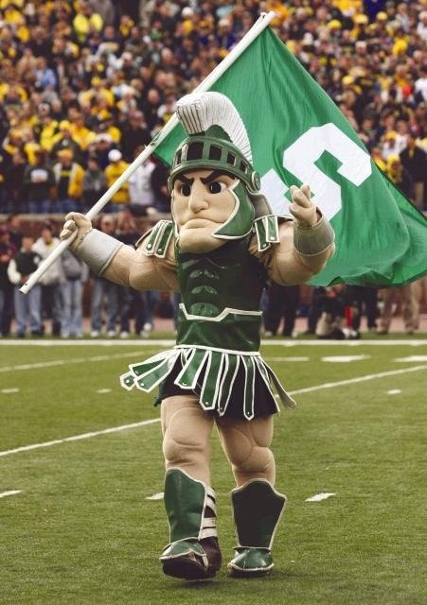

Social identity
“part of an individual’s self-concept derived from membership in a social group together with the value and emotional significance attached to that membership”
    Tajfel (1973)

Slide 4
What constitutes a stigmatized identity?
others hold negative attitudes, stereotypes and beliefs
devalued in a particular context
Notes:
In this talk I will focus on examples of those identities associated with underrepresentation in the workplace and in certain occupations – specifically race, ethnicity and gender – but in your particular context there may be other identities that are stigmatized – for example, those possessing a degree from a non-prestigious university, those who are non-native English speakers, those with certain career paths. So I encourage you to think broadly when I mention “identity”

Slide 5
Social Identity Concerns
Authenticity
Trust/fairness
Belonging
Identity Contingency Cue
Make identity salient
Make stereotype salient
Stereotype confirmation concerns (stereotype threat)
Signal
Identity Threat
Identity Safety
Notes:
Identity contingency cue: Judgment, stereotype, opportunity, restriction tied to social identity in a setting
Social identity concerns: things we worry about, but specifically what we worry about because of a particular
Will talk specifically about stereotype threat a bit later as that is a specific and perhaps more controversial issue and I want to alert you to some in press work on the topic

Slide 6
Social Identity Concerns
Authenticity
Trust/fairness
Belonging
Identity Contingency Cue
Stereotype confirmation concerns (stereotype threat)
Numerical Representation
Signal
Threat
Safety
Notes:
Example: cue of how many people like me are here applying for this job/taking this test, work here, succeed here?
Women applying for a male-dominated position – math professor.
If the numerical representation is low – other applicants, the recruiting team, people depicted on the website, people I encounter during my interview, it might raise concerns about whether I will fit in, whether I can be myself, whether I will be treated fairly. (the specific instance of stereotype threat would I underperform on some task because of the stereotype and my concerns about confirming it, conscious or unconscious)
If the numerical representation shows a critical mass (typically people talk about 15%), I perhaps won’t have those concerns – I will get a signal of safety rather than threat

Slide 7

Identity contingency cues in recruiting and selection
Notes:
First few will be obvious ones and I’ll just go through quickly – you probably think about them already and recognize them as signals that are either good or poor in your various contexts.
However, for each I will try to give you an example of how technology might affect this so we can focus on emerging issues in assessment

Slide 8
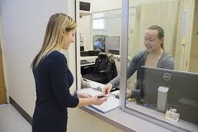

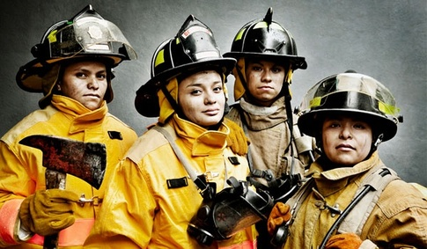


Representation
Notes:
The one set of cues I just mentioned relate to representation -- this can be who is in the testing room, who is on the job, who is shown on a website, but also “encounter demographics” – who do I meet and what are they doing.
e.g., Walker, Field, Bernerth & Becton 2012 manipulated racial diversity on websites and found differences in time spent on site and recall of info; Also reviewed and coded actual websites; found more info processing for both Blacks and Whites when diversity cues present

Slide 9
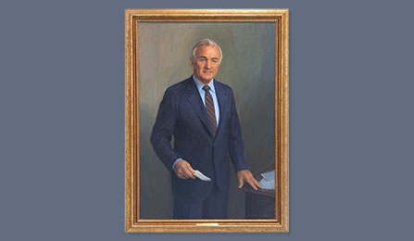
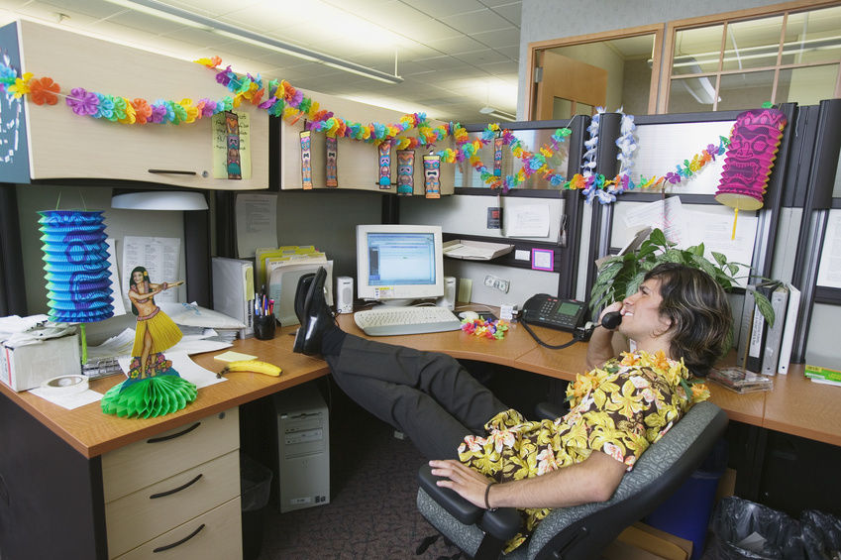
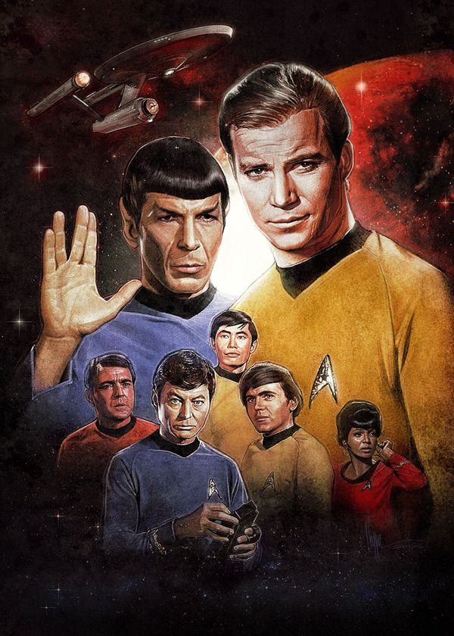
Ambient Identity Cues
Notes:
Environmental cues signal lack of belonging
Further, there is other research though to show that if the identity cues in a space are in-group (e.g., you are on the blue team and the room is decorated in blue) you perform better – identity cues can signal safety and help performance. (Greenaway, Thai, Haslam & Murphy 2016.

Slide 10

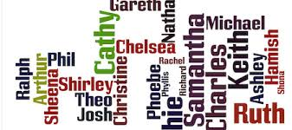

Representation/ambient cues in assessment
Names/pronouns
Mobile/UIT
Animated/avatar
Notes:
1. names/pronouns in written sjts – we looked at this in terms of Stereotype threat a few years back but have not really looked systematically at effects on some of the other social identity concerns and signals
2. Internet and mobile testing means the test-taker controls who is and isn’t in the physical environment…… that should be good right? Might not have low representation, might decorate your own room in ways that make you feel comfortable.
3. as the test developer you control representation in the virtual environment
Who is in the environment and what roles do they have? What does environment look like?
We have research emerging on the effects of contextualization – the idea that providing context might make it easier for people to answer questions and lead to better prediction BUT we need to think about how we are adding contextualization (e.g, games)
Really interesting research (e.g. Lee 2010) that shows that regardless of participants’ actual gender, the gender of the avatar used by participants as well as the number of opposite genered avatars induced stereotype threat for “virtual females” on math problems, with sterotype lift or better performance of male-avatars.
There is other research to add here

Slide 11
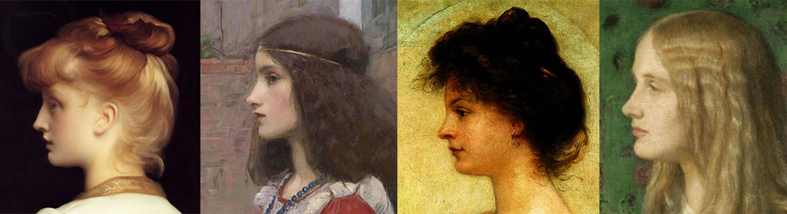
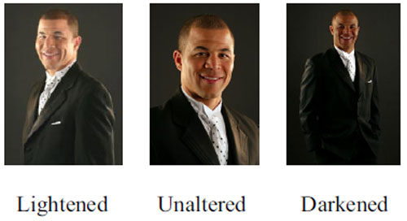
Subtleties
Suitner, Maass & Ronconi 2017
Kahn, Unzueta, Davies, Alston & Lee 2015
Notes:
Another example:
Graphs in science tend to have the data for males to left of data for females (Hegarty & Buechel 2006) and in portraits females are more often portrayed facing left than males (Suitner & McManus, 2011) (except for queens who are more powerful) – this seems like nothing except that agency is seen as revealed by the left-right trajectory – what is more agentic is to the left. So if you want to really go down in the weeds – are your female avatars to the right of the male ones, are women facing to the left and not right in photos on website, etc… at a disporporionate rate
-- Suitner, Maass & Ronconi 2017.
Other research on cues looks at phenotypic racial stereotypicality –
Low phenotypic stereotypic (e.g., light skin, straight haired Black) – Kahn et al manipulated the phenotypic stereotypic photographs of Black employees on web sites (skin tone, nose, lips) and found Blacks expressed more trust and comfort for the organization that had high phenotypical stereotypic, saw as more diverse and higher desire to work for that organization

Slide 12
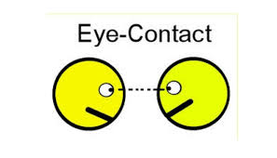

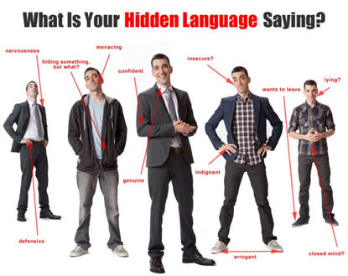
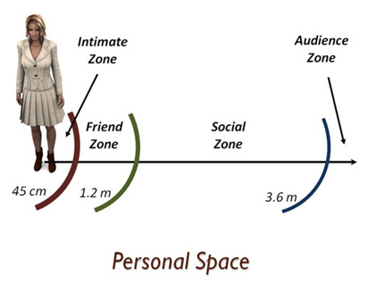
Interpersonal interactions
Notes:
1. We already can think of the obvious in terms of interpersonal treatment that might signal an identity threat or safety and we train interviewers and others who interact with candidates and we hold them accountable
2. But research on subtle discrimination suggests Body language, eye contact, distance are all signals that someone might perceive as signaling identity threat – those are a lot harder for us to give feedback on.
as example Logel, Walton, Spencer, Iserman, Von Hippel & Bell 2009 had male partners use more dominant facial expressions and display more open body postures when in conversations with female engineering students who subsequently performed more poorly on engineering test than with partner who did not use the same body language.

Slide 13
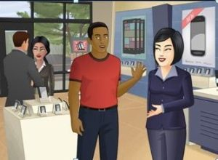

Interpersonal interaction in assessment content
Who
How
Nature of interaction
  Conflict
  Cooperation
Effects on construct assessed
Notes:
This is screen shot form a PSI SJT – I am not using it as an example of anything wrong – it was just an available one.
But are we thinking about cues – who is in what role, how are they interaction?
Some findings:
Research with Juliya Golubovich at ETS on video SJTs and depiction of race and gender in situations involving both conflict and cooperation – we do find some performance differences for ethnic minorities when they are assuming a role interacting with an individual of the same or different racial background in situations of conflict.
Research in general would suggest people are more likely to help a woman than man in any scenario; may be complex ---
women received less help from fellow players than men when they operated a male avatar
My point is we all make sure that content reflects diversity – at least in terms of race and gender (although not always in terms of age); however, are we careful about exactly how we are representing the diversity in interactions; are we considering how an individual applicant’s identity interacts with the scenario.
Further, how does the choice affect the construct assessed --

Slide 14

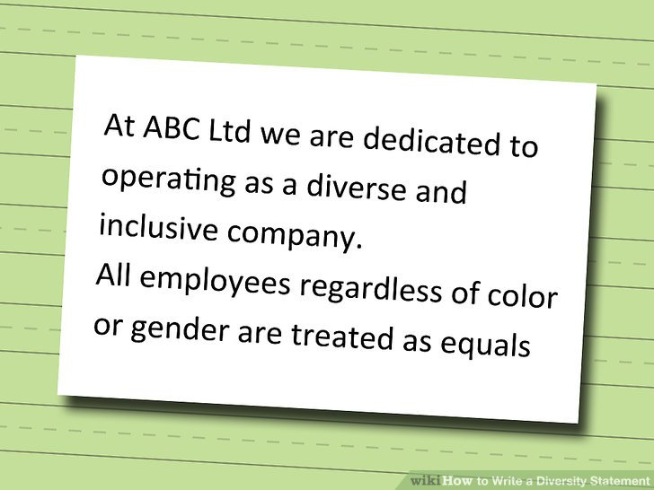

Diversity Structures
Colorblind messages are viewed negatively relative to multicultural messages
Wilton, Good, Moss-Racusin & Sanchez, 2015
Law firms with diversity statements that emphasize difference had lower attrition rates among White women; those that emphasize equality had lower attrition among Black women
Apfelbaum, Stephens and Reagans 2016
Notes:
These would be things like diversity statements, evidence of diversity commitment such as training programs or awards – we generally see these as sending signals of belonging, safety to minority and female applicants…
I will talk more about research on that premise in a second.

Slide 15
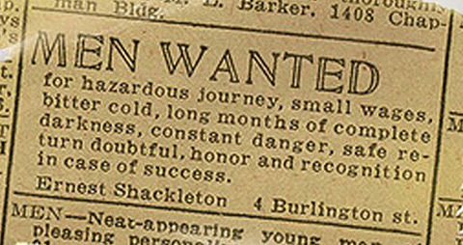
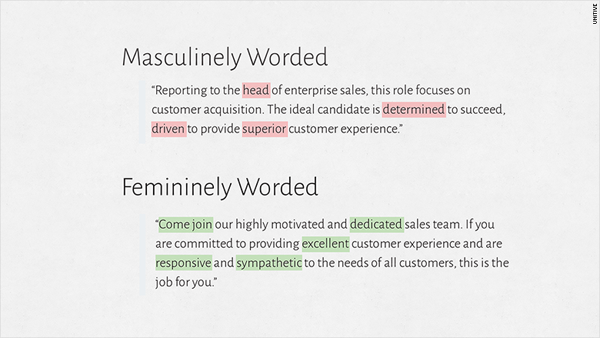
Advertisement language
Gaucher, Friesen, Kay 2011
McCusker, Foti & Shah 2017
Wille & Derous 2017
Notes:
Lots of emerging research on this topic showing that word choice in advertisement that has a more communal versus agentic language can change attractiveness to men versus women –
Research shows that use of male –dominated words such as competitive and dominant are more common in job ads in male dominated fields
Also shows women find those jobs less appealing and affected application intentions
The Wille & Derous study did not look at gender and wording but at mentioning of meta-stereotypes (e.g., if an ethnic minority group is stereotyped as dishonest and the ad mentions integrity)
Obvious issues on sensitivity reviews of test content
MAYBE ADD COMMENT ON OUR RESEARCH ON THIS TOPIC

Slide 16
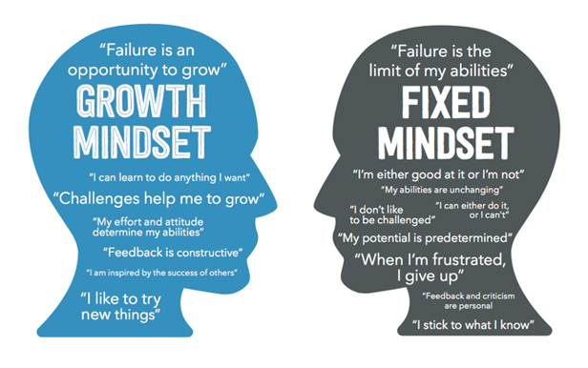
Assessment instructions
Entity v. incremental
Signal through retesting policy
Organizational description as performance-oriented, recruiting the best, rewarding intelligence versus growth-oriented and encouraging love of learning
      Emerson & Murphy 2015

Slide 17
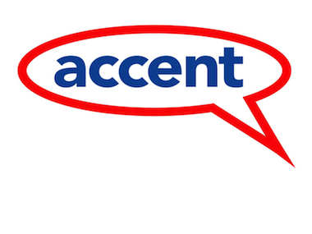

Response Format Choices
Modular View of Procedures (Lievens & Sackett, 2017)
-- response format
webcam (assessment or interview)
video resume
Notes:
How do these formats affect identity salience and how might that affect concerns – e.g., a pregnant candidate might prefer a telephone to video interview as it would not reveal information she may not wish to reveal at an early stage in the process. A candidate with an accent might prefer an SJT where he gives a written or multiple choice response than a simulation involving a webcam.
New is not always better – both for construct being assessed and for acceptance.

Slide 18

Things to worry (wonder) about: mixed messages cue transfer ironic effects

Slide 19

Mixed messages
Pro gender diversity statement and male dominated board
  Windscheid, Bowes-Sperry, Kidder, Cheung, Morner & Lievens 2016
  Wout, Murphy & Barnett 2014
Threat seems to override safety cues
Do some identity contingency cues trump others?
Notes:
What if your situation is one of mixed messages – how will you work with that

Slide 20




Cue Transfer
Chaney, Sanchez & Remedios 2016
Notes:
Resarch by Chaney et al showed that identity safety cues transferred from knowing about a racial diversity award to beliefs about how white women would be treated. Idea is that believe attitudes are overlapping.
However, they raise the questions of will all cues transfer? Maybe it is true if groups are similar in stereotypes and status but not otherwise?

Slide 21
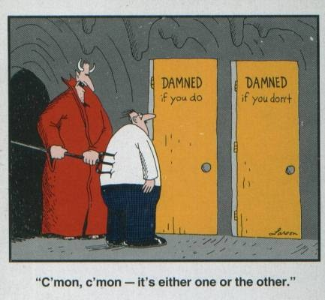
Highlighting the pervasiveness of stereotyping leads to greater expression of stereotypes and treating people in more stereotype consistent ways
    Dugid & Thomas-Hunt 2015
Positive stereotypes can have negative effects as they are depersonalizing
    Emerson & Murphy 2014; Zou & Cheryan 2015
  Personalizing can be challenging!

Slide 22
Ironic effects of diversity structures
Diversity structures create an illusion of fairness such that individuals become less sensitive to discrimination
  Moral credentialing
  Kaiser, Major, Jurcevic, Dover, Brady, Shapiro 2013
  Brady, Kaiser, Major & Kirby 2015
  Kirby, Kaiser & Major 2015

Slide 23

Back to stereotype threat effects…
  the within-group phenomenon of test underperformance of stereotyped groups when under threat relative to their own performance when not threatened
    Minority test takers and cognitive ability tests
    Female test takers and math tests
Notes:
Stereotype threat is awareness of stereotype and then engage in a behavior – it doesn’t mean there necessarily was a particular identity cue in the situation; also identity cues like diversity ideologies don’t have to do with stereotypes but affect feelings of belonging

Slide 24
Stereotype threat
NR2008
Zigerell in press
Overall effect -.26 (k = 116)
Hunter Schmidt
  Weight by sample size
Publication bias
  Fail safe N, eyeball funnel plot
  be cautious for moderator analyses
Overall effect -.38 (k =114)
Hedges & Vevea
  Weight by inverse sampling error variance
Publication bias
  Trim & fill; top 10%; PET-PEESE
  From no change to 50% reduction to zero effect
    Issues of methods with small ks and small Ns in original studies
Current conclusion:
“inconclusive” on size of effect and extensiveness of publication bias
100s of newer studies – need an updated meta-analysis

Slide 25
Ryan & Sackett: Theoretical boundary conditions of ST
Consistent stereotype exists and group members aware of existence.
Assessment/task is seen as diagnostic
Stereotype relevant to the individual during assessment
Task/assessment “at the frontier of a person’s skills” (Steele, 2010); i.e., highly difficult
Individual identifies with the domain; cares about being seen as being skilled and capable in that domain.
Some level of identification with the stereotyped group exists.
Notes:
In a chapter we wrote

Slide 26
Interventions for ST and applicability to employment testing
Nullify the stereotype
Describe the assessment as non-diagnostic
Test in a same-group environment
Affirm the self
Frame the characteristic being assessed as malleable
Increase accessibility of social identities associated with positive stereotypes in the domain
Teach individuals about stereotype threat
Expose individuals to positive role models and positive social comparison information
Reframe the assessment
Notes:
At the time, concluded many of these are not feasible for employment contexts – but quite honestly some are now or are pseudo happening anyway

Slide 27
Intervening
Remove or change the cue
Values affirmation
  Kinias & Sim 2016
  Values assessments
  Culture fit assessments
Expectations interventions
  Pay more attention to threatening cues if you anticipate being devalued
      Kaiser, Vick & Major 2006
Notes:
Typical values affirmation is to give a list of 10 values and select what is important to you and reflect on why they are important to you.
(e.g., Kiniias & Sim 2016)
Expectations of being devalued – research is with reaction time to words -- you can’t do anything about a person’s life experiences and chronic expectations; however, you can do something to address expectations if you feel they are prevalent in association with your setting (e.g., police and fire assessment)

Slide 28

Intervening
Virtual job tryouts as an opportunity
  Expose to representations of who belongs, who and what is valued
Notes:
Example is from Shaker Consulting – once again not an endorsement or a statement against…..

Slide 29
Social Identity Concerns
Authenticity
Trust/fairness
Belonging
Stereotype confirmation concerns (stereotype threat)
Interventions can fail if they are targeting the “wrong concern”
Interventions at the wrong time might not be meaningful
Notes:
Walton & Brady chapter suggests this.

Slide 30

Identity contingency cues relate to identity concerns and can trigger perceptions of identity safety or threat
Recruiting and assessment contexts may have a lot of subtle cues
  Monitor for potential threat
  Promote perceptions of safety

Slide 31
Thank you!
For more information, contact ryanan@msu.edu

