Slide 1
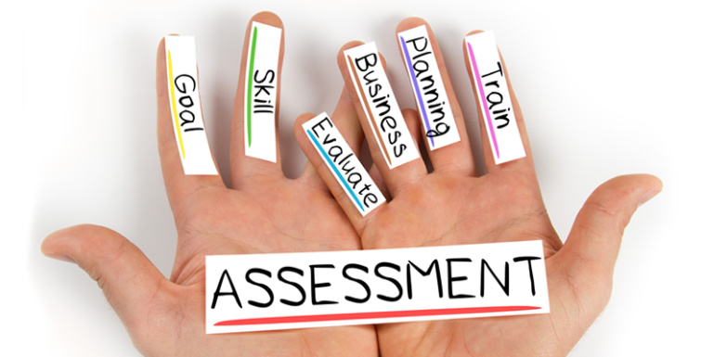
Assessing the Assessments: The Advantages and Disadvantages of Nine Common Psychometric Tools
Kelsey Stephens, M.S.
Talent Measurement Consultant

Slide 2
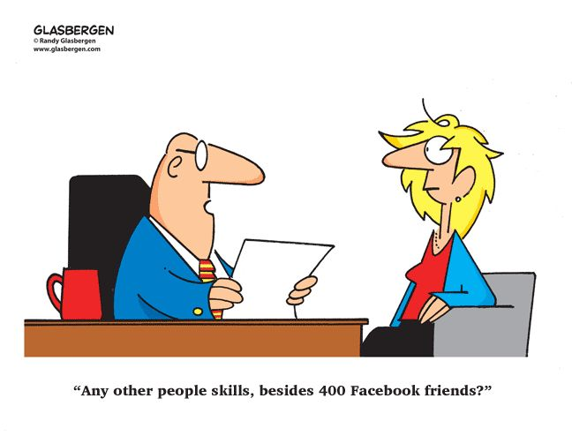
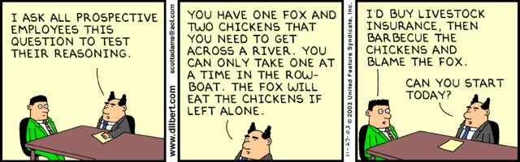

Slide 3
Presentation Overview
Introduction to assessments
Discussion of nine assessment types
  Goal and definition
  Example item
  Advantages and disadvantages
  Use cases
Q&A

Slide 4
POLL QUESTION:
Are you using any kind of assessments in your hiring or development programs right now?
?

Slide 5



Slide 6

Hire-to-Retire Content
Cognitive Ability
Skills and Knowledge
Biodata
Integrity
Situational Judgment
Values
Personality
Structured Interviews
360-degree Feedback

Slide 7
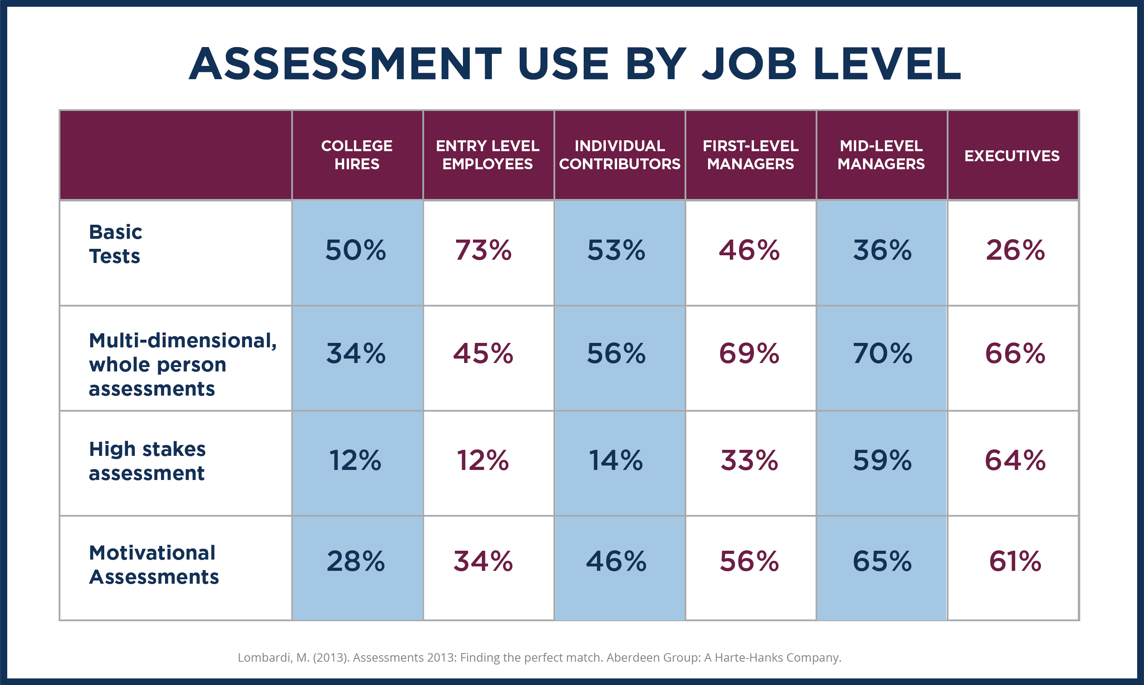

Slide 8
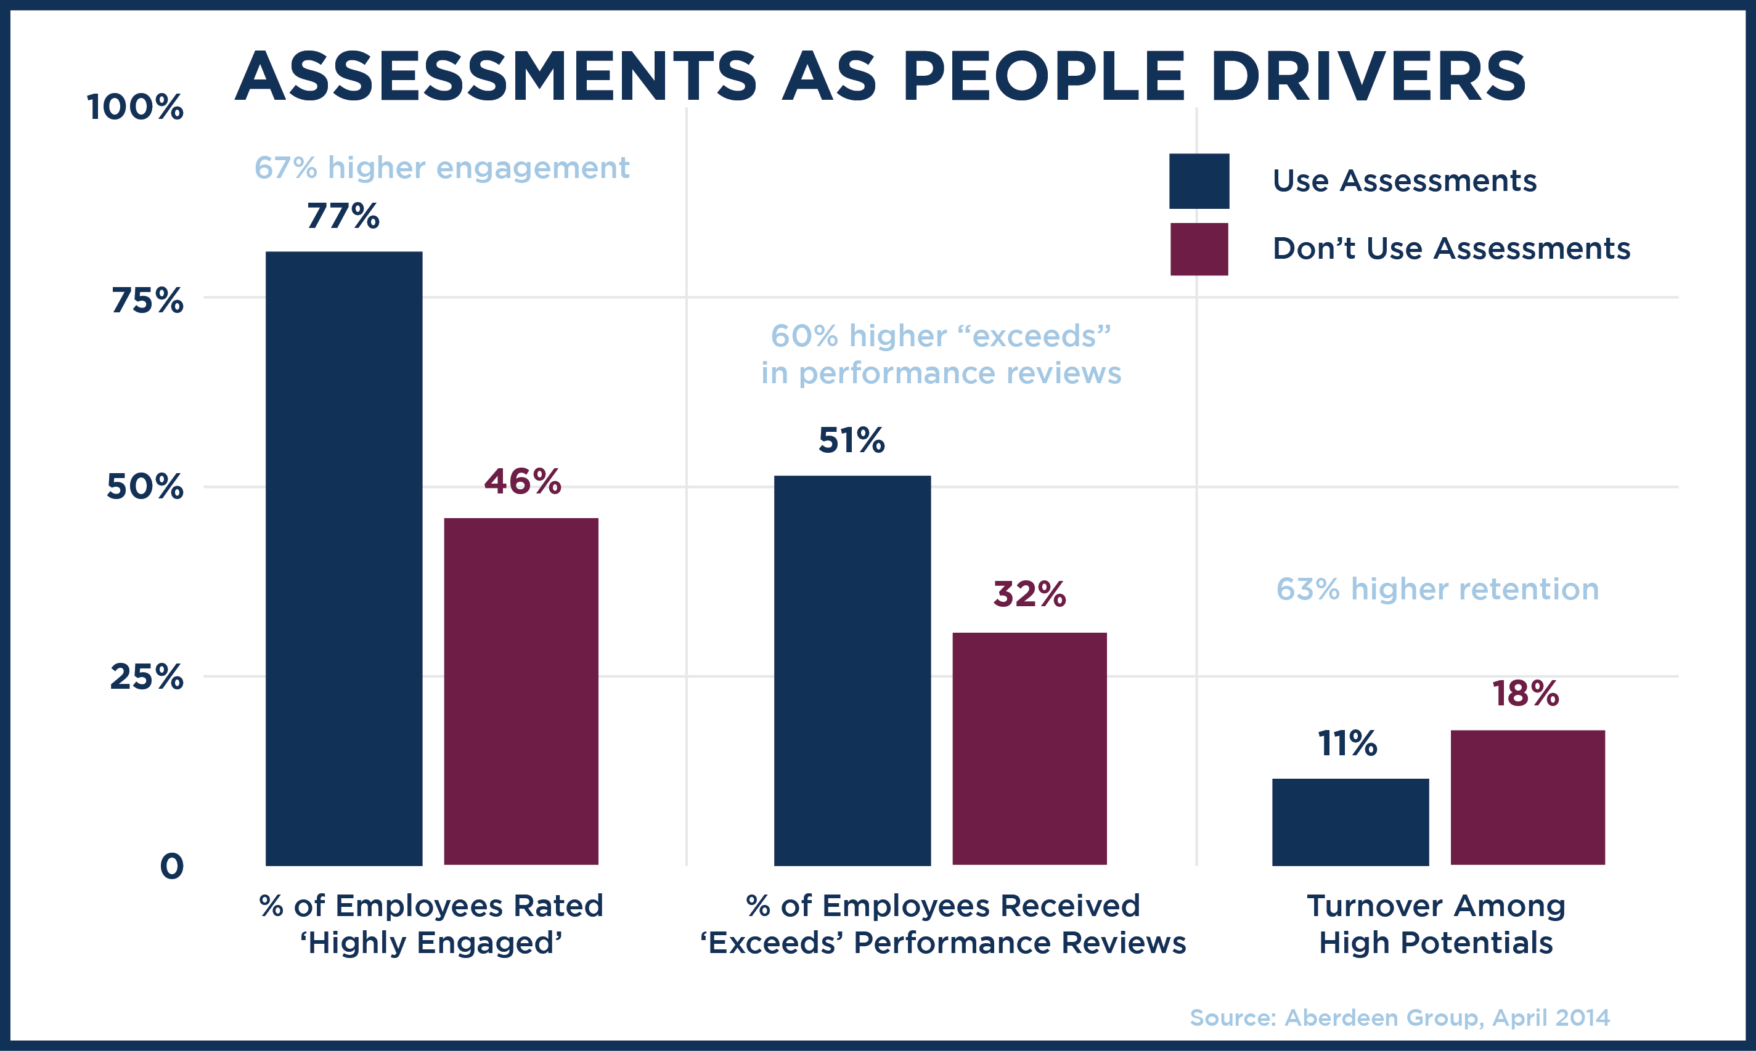


Slide 9
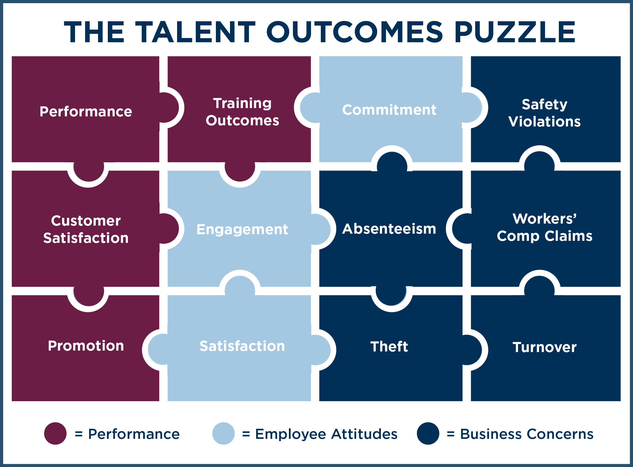

Slide 11










The 9 Assessment Types
Situational Judgment Items
Cognitive Ability
Skills and Knowledge
Structured Interviews
Personality
360-Degree
Feedback
Integrity
Biodata
Values

Slide 12

Cognitive Ability
Definition | Example | Advantages | Disadvantages
Assess abilities involved in thinking critically (e.g., reasoning, perception, memory, verbal and mathematical ability, and problem solving) | Which of the following words is an antonym to the word theory? A. calculation B. guess C. ideology | Easy to use off-the-shelf; strong predictor of job performance for a wide variety of jobs | Low face validity and job-relatedness; can often produce racial/ethnic differences

Slide 13


Use Cases for Cognitive Ability Tests
Deductive Reasoning
Spatial/Visual Aptitude

Slide 14
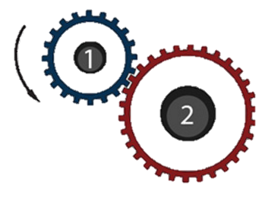

Skills and Knowledge
Definition | Example | Advantages | Disadvantages
Evaluate what a person knows at the time of taking the test |  | Knowledge areas tested are designed to be very representative of the knowledge areas and skills required to perform the job, which means they should be predictive of high performance | Can inform employers what an applicant currently knows, but not whether the individual can be relied on to master new material; may require frequent updates

Slide 15


Use Cases for Skills and Knowledge Tests
Medical Field
Accounting

Slide 16

Personality
Definition | Example | Advantages | Disadvantages
Designed to systematically elicit information about a person’s motivations, preferences, interests, emotional make-up, and style of interacting with people and situations | “I find it easy to influence others” (Agree to Disagree Likert-rating scale) | Good for when you need applicants who possess strong interpersonal skills or other job-related specific personality traits; more difficult to fake because there's no "wrong" type of personality | Can be time intensive to complete; candidates may engage in creating a profile that is socially desirable

Slide 17
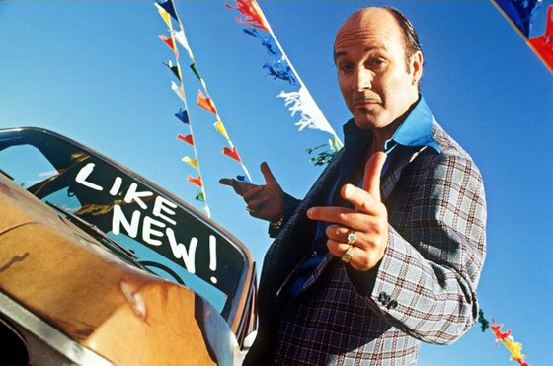

Use Cases for Personality Assessments
Sales Roles
Service Roles

Slide 18

Integrity
Definition | Example | Advantages | Disadvantages
A specific type of personality test designed to assess an applicant’s tendency to be honest, trustworthy, and dependable | How justifiable is the following situation? “Avoiding paying the fare on public transit” | Limit counterproductive workplace behaviors; inform candidates that integrity is an important organizational value | May seem unnecessary and invasive; some items are highly transparent, making it easy to fake

Slide 19
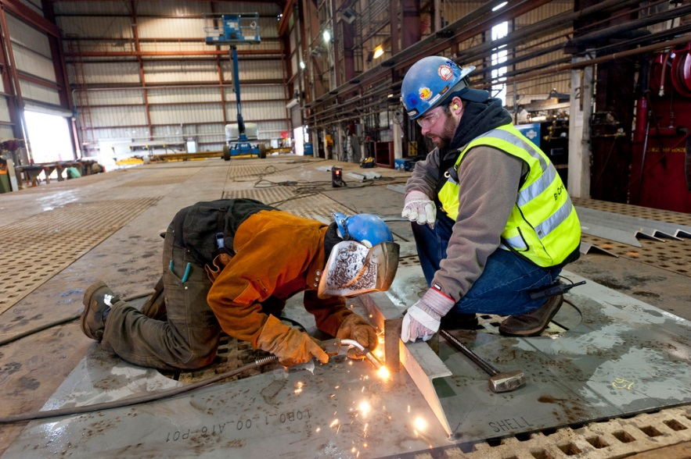

Use Cases for Integrity Tests
Workplace Safety and Compliance
Honesty and Confidentiality

Slide 20

Values
Definition | Example | Advantages | Disadvantages
Compare applicant personality, interest, value, or organizational culture preference information to the characteristics of the job or organization | “In my spare time I like to go to museums or attend orchestra concerts” (Agree to Disagree Likert-rating scale) | Good for selecting individuals who will fit well in the organizations (i.e. decreasing voluntary turnover); taps into what someone wants to do rather than what they may do | Lower predictive validity than other assessment tools

Slide 21


Use Cases for Values Assessments
Culture Fit
Culture Fit
Leadership

Slide 22

Biodata
Definition | Example | Advantages | Disadvantages
Inquires about past events and behaviors that reflect personality attributes, attitudes, experiences, interests, skills, and abilities | In the past, how often have you needed to communicate complex information to people unfamiliar with technical details? Frequently Usually Occasionally Rarely Never | Have been shown to be effective predictors of job success in numerous settings and for a wide range of criterion types | Makes the assumption that past behavior is the best predictor of future behavior; can be transparent and easy to fake

Slide 23


Use Cases for Biodata
Understand Interest in Different Industries
Mitigate Adverse Impact

Slide 24
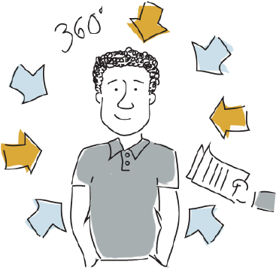
360-degree Feedback
Definition | Example | Advantages | Disadvantages
Evaluations gathered about a target participant from two or more rating sources (self, supervisor, peers, direct reports, internal customers, external customers, and vendors or suppliers) | This person shares information widely and does not withhold information from others (Agree to Disagree Likert-rating scale) | Multiple viewpoints can increase reliability and validity; gives a fuller picture of performance; calls attention to performance dimensions that would otherwise be neglected | Can be costly (monetary resources as well as employee time); organizations sometimes fail to explain purpose of 360 feedback or to adequately debrief employees on their ratings

Slide 25


Use Cases for 360-degree Feedback
Development
Administrative Decisions

Slide 26

Structured Interviews
Definition | Example | Advantages | Disadvantages
Interviews that employ structured rules for eliciting, observing, and evaluating responses, thus limiting the amount of discretion the interviewer is allowed | Tell me about a time when you tried to encourage someone to take action and had to change your communication style to effectively meet that person’s needs | Helps to ensure candidates have equal opportunities to provide information and are assessed consistently; can evaluate competencies that are difficult to measure using other assessment methods | Even though it is a standardized process, we're only human, so it's still possible for bias to creep in; can be time-consuming

Slide 27


Use Cases for Structured Interviews
Communication-related Roles
Detailed Information is Desired

Slide 28
Situational Judgment
Definition | Example | Advantages | Disadvantages
Present applicants with a description of a work problem or critical situation related to the job they are applying for and ask them to identify how they would handle it | You have been assigned to work with members of another department. You normally complete your work alone, but the project demands that you work as a team. Rate the effectiveness of the following actions. | Perceived as very fair (high face validity); tasks and activities are very representative of the tasks and activities found on the job (high content validity) | Can be costly to custom build; heterogeneity such that a single item can measure many constructs and competencies

Slide 29


Use Cases for Situational Judgment Tests
Leadership Positions
Customer Service Roles

Slide 30
Summary of Nine Assessment Types
Many different types of assessments exist
Consider the reasoning behind your interest in assessments
  At what point in the selection process will you use the assessment?
  Are you wanting to identify leadership potential?
  Do you want to reduce counterproductive workplace behaviors?
  Do you want to ensure your employees match the organization's culture?
Always consider the psychometric stability of your selected assessment

Slide 31
Questions?
Kelsey Stephens kstephens@panpowered.com
?
?
?
?
?
?
?
?
?
?
?
?
?
?

